Slide 1



Falling through the Gaps
WELCOME

Slide 2
Falling through the Gaps
About today
Housekeeping
  Please turn phone to silent

Slide 3
Falling Through the Gaps
Connecting Research, Policy and Practice in the Fields of Ageing, Falls Prevention and Housing Interventions
Sue Adams, Care & Repair England

Slide 4
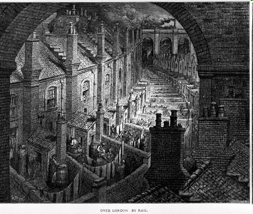
Background to today’s event
Addressing the health / social problems arising from housing inadequacy were key drivers of housing improvement
Need to be again

Slide 5
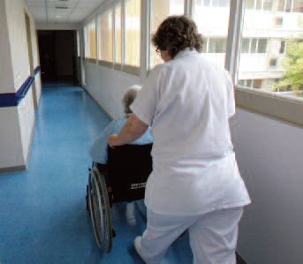
Major current policy concerns
Reduce NHS costs
Reduce care costs
Focus: Older people
[CSR underway]

Slide 6
Where older people live
90% of older people live in mainstream housing (6% specialist/ 4% res care/other) other)

Slide 7
Where older people live
One out of 3 homes are lived in by older people
75%+ owner occupied

Slide 8
Housing & health risks: Quantify
3.1 million dwellings (14% of stock) had at least one Category 1 Hazard
  1.8 million have Cat 1 hazard for risk of falling
  1 million have Cat 1 hazard for Excess Cold
  1 million households live with some form of damp
  Most defects in the private sector (rented & owned) so must have cross tenure solutions
Source: DCLG, 2014, English Housing Survey 2012 Profile of English Housing report. Hazards defined using Housing Health and Safety Rating System

Slide 9

Making best use of scarce resources
Falls – new C&RE paper
Hip fractures cost £2b+ pa
12 month cost to health and care for 421 falls patients in Torbay was £5 million (Kings Fund Study)
New Zealand 3yr RCT – home adaptations reduced injuries from falls by 26%

Slide 10
Hope that today will…….
Promote understanding of subject and stimulate fresh thinking and action
Encourage more researchers to study in this field
Connect researchers with those delivering falls prevention through housing adaptations

Slide 11
Falling through the Gaps
Lord Filkin
Centre for Ageing Better
The importance of understanding and applying 'what works' in an ageing society

